Slide 1
Effective Communication and Stakeholder Engagement
Enhancing Leadership through Communication
BEGIN

Slide 2
AGENDA
01
02
04
03
Learning Objectives
Understanding Stakeholder Engagement
Communication Styles and Strategies
05
06
Scenarios
Q&A
Impact on School Culture

Slide 3
01
Learning Objectives
Goals

Slide 4

OBJECTIVES
LO – Cognitive #1
LO – Cognitive #2
Identify the various communication styles and strategies appropriate for different stakeholders, including staff, parents, and students.
Analyze the impact of effective communication on stakeholder engagement and school culture.

Slide 5
AGENDA
01
02
04
03
Learning Objectives ✅
Understanding Stakeholder Engagement
Communication Styles and Strategies
05
06
Scenarios
Q&A
Impact on School Culture

Slide 6
02
Understanding Stakeholder Engagement
Staff, Parents, Students

Slide 7

Stakeholder Engagement
Definition: “Any group or individual who can affect or is affected by the achievement of the organization’s objectives” (Freeman, 1984, p. 46).
Purpose: Fosters collaboration, trust, and a sense of belonging within the school community.

Slide 8
Key Groups
Staff
Parents
Students
Professional Development
Workplace Culture
Child’s Education
Involvement Opportunities
Learning Experience
Extracurricular Activities

Slide 9
AGENDA
01
02
04
03
Learning Objectives ✅
Understanding Stakeholder Engagement ✅
Communication Styles and Strategies
05
06
Scenarios
Q&A
Impact on School Culture

Slide 10
03
Communication Styles and Strategies
Assertive, Passive, Aggressive, Passive-Aggressive

Slide 11




Communication Styles
Assertive
Passive
Expressing one’s needs, thoughts, and feelings clearly and respectfully
Avoids expressing one’s needs to prevent conflict or tension
Aggressive
Passive-Aggressive
Defensive and confrontational – disregards the feelings of others
Appearing passive, but indirectly and subtly acting out in anger
Notes:
Source: https://umatter.princeton.edu/respect/tools/communication-styles#:~:text=There%20are%20four%20main%20styles,passive%2Daggressive%2C%20and%20assertive.

Slide 12
Communication Examples
Assertive
Passive
An assertive response to a colleague's repeated interruptions during a meeting would involve calmly addressing the interruptions, saying something like, "I appreciate your input, but I'd like to finish my thought before we discuss that.”
A passive response to a colleague's repeated interruptions during a meeting might involve staying silent and allowing the interruptions to continue without addressing the issue directly.
Aggressive
Passive-Aggressive
An aggressive response to a colleague's interruptions might involve shouting, "Can't you see I'm talking? Stop interrupting me!"
If a colleague repeatedly interrupts during a meeting, a passive-aggressive response might involve rolling one's eyes or sighing loudly without addressing the interruptions directly.

Slide 13
Strategies
Staff
Parents
Students
Regular Team Meetings
Frequent Feedback
Open-Door Policy
Newsletters
Active Listening
Student Forums

Slide 14
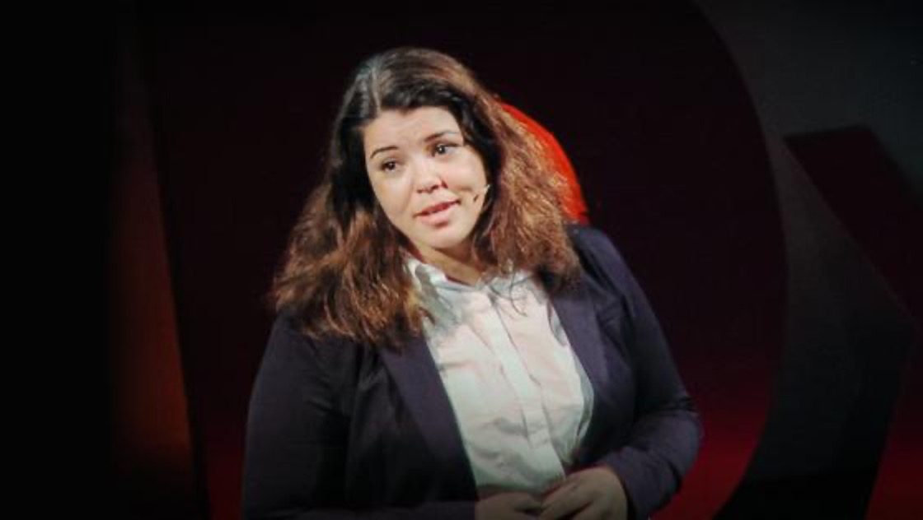
Video
10 Ways to Have a Better Conversation by Celeste Headlee

Slide 15
AGENDA
01
02
04
03
Learning Objectives ✅
Understanding Stakeholder Engagement ✅
Communication Styles and Strategies ✅
05
06
Scenarios
Q&A
Impact on School Culture

Slide 16
04
Impact on School Culture
Shared Values, Beliefs, and Behaviors

Slide 17

School Culture
Definition: “The belief and attitude influencing every aspect of how a school functions” (Lewis et al., 2016, p. 57).
Effective communication influences and shapes school culture.
Positive Impact:
Trust
Collaboration
Inclusivity
Innovation

Slide 18
AGENDA
01
02
04
03
Learning Objectives ✅
Understanding Stakeholder Engagement ✅
Communication Styles and Strategies ✅
05
06
Scenarios
Q&A
Impact on School Culture ✅

Slide 19
05
Scenarios
Supervisors with Direct Reports, Team, and Parents

Slide 20

Your Turn to Practice!

Slide 21

Scenario #1 – Supervisor and Direct Report
The supervisor needs to provide constructive feedback to a direct report who has been struggling with meeting project deadlines. The goal is to address the issue professionally and offer support.
What is your response?

Slide 22
Scenario #2 – Supervisor and Entire Team
The supervisor needs to address the entire team regarding a recent change in project priorities. The goal is to communicate the change clearly, address concerns, and maintain team morale.
What is your response?

Slide 23
Scenario #3 – Supervisor and Parent
The supervisor needs to meet with a group of parents to discuss a new school policy. The goal is to listen to parents' concerns, provide explanations, and foster a positive relationship.
What is your response?

Slide 24
AGENDA
01
02
04
03
Learning Objectives ✅
Understanding Stakeholder Engagement ✅
Communication Styles and Strategies ✅
05
06
Scenarios ✅
Q&A
Impact on School Culture ✅

Slide 25
06
Q&A
Write in your questions!

Slide 26
AGENDA
01
02
04
03
Learning Objectives ✅
Understanding Stakeholder Engagement ✅
Communication Styles and Strategies ✅
05
06
Scenarios ✅
Q&A ✅
Impact on School Culture ✅

Slide 27
—James Humes
“The art of communication is the language of leadership.”

Slide 28
References
Freeman, R. E. (1984). Strategic management: A stakeholder approach. Pitman.
Lewis, J., Asberry, J., DeJarnett, G., & King, G. (2016). The best practices for shaping school culture for instructional leaders. Alabama Journal of Educational Leadership, 3, 57-63. https://files.eric.ed.gov/fulltext/EJ1120644.pdf
Princeton University. (n.d.). Understanding Your Communication Style. https://umatter.princeton.edu/respect/tools/communication-styles#:~:text=There%20are%20four%20main%20styles,passive%2Daggressive%2C%20and%20assertive.

Slide 29
THANKS!
Do you have any questions?
Lauren C. Batista
University of Florida
EME6609
facebook.com/Freepik
@Freepik
company/freepik-company
Please keep this slide for attribution

